Slide 1

E-Commerce Analytics
A project by Jayesh Salunkhe

Slide 2
PARTICULARS
Underlying Objectives
About the data
Data Pre processing
Exploratory data analysis and insights
RFM
K-means clustering
Conclusion

Slide 3
Objectives
Provide meaningful insights from data.
Find areas of improvement for business.
Divide customers in segments based on similar shopping behavior.
Build an unsupervised learning model to analyze customers characteristics via RFM (Recency, Frequency and Monetary value) approach.

Slide 4
ABOUT THE DATA
Data Shape: 5,37,979 rows X 12 columns.
The data contains details of e-commerce transaction of customers from 2016 (December) to 2017(January to December) i.e. 13 months.
About the columns:
Column Name | Description | Missing Observation | Data Type
Customer ID | Unique identifier for each Customer | 1,33,789 (25%) | Float64
Item Code | Unique id for each product | - | Int64
Invoice No | Unique id for each purchase | - | Int64
Date of purchase | Date on which the purchase was made | - | Datetime64[ns]
Quantity | Number of items bought for each product | - | Int64
Time | Time at which the purchase was made | - | Object
Price per Unit | Price of single unit of item purchased | - | Float64
Price | Total purchase price | - | Float64
Shipping Location | Delivery Location | - | Int64
Cancelled status | Status of Cancellation | 5,29,624 (98%) | Float64
Reason of return | Reason for return of product | 5,37,975 (100%) | Object
Sold as set | Was the product sold with another product/ Offer | 5,37,978 (100%) | Float64

Slide 5

Data Pre-Processing
Missing Customer ID
The customer ID column had missing values. (1,33,790 (25%))
Imputing individual invoices as new customer would lead to a skew towards one time buyers.
Exclude observations with blank Customer IDs to avoid impact on customer segmentation.

Slide 6
Data Pre-Processing
The Cancelled status column showed ‘True’ for orders which were cancelled with a – ve entry. (8,183 (2%))
We exclude the cancellation observations from the data in line with our focus to study purchase patterns.
This further removes all negative values from quantity, price per unit and Price columns.
Cancelled Orders
Variables deleted
Column names: Cancelled Status, Reason of Return and Sold as set
After removing the blank observations from Customer ID and observations for cancelled orders, these 3 columns remain blank and were excluded from the data.
Duplicate Entries
The data contained 8 duplicate (identical) entries.
These were excluded to avoid data redundancy.
Outliers
The data shows a sudden spike in values after the 99th percentile which affected the calculations for the overall data.
Observations with outliers in the Quantity, price per unit and Price column after 99th percentile were excluded.
Data cleaning leaves us with 74% of the original data (3,94,655 observations)

Slide 7
EDA & Data Insights
Objective 1: Provide Meaningful Insights from the Data
OVERVIEW OF THE DATA
Business data stores individual entries for each item purchased by a customer.
Some invoices show different dates of purchase.
We have 4310 customers who placed 18,143 orders during the 13 months.
The company sells 3620 unique products which are shipped across 20 locations.
Some Item codes are alpha numeric depicting product variants for a single product.
Invoice dates range from 2nd December 2016 to 19th December 2017.

Slide 8
EDA & Data Insights
Objective 1: Provide Meaningful Insights from the Data
Observation:
Shipping Location 36 is the biggest revenue generator for the business contributing to 92.7 % of the company’s total revenue.
Recommendation:
Increasing sales and campaigns across other location can bring an increase in revenue and grow the company’s business in the market.
There is an increase in sales during the weekend, every week

Slide 9
EDA & Data Insights
Objective 1: Provide Meaningful Insights from the Data
Observation:
Locations 14, 26, 15, 1 and 11 are top 5 revenue generating shipping locations after location 36.
Recommendation:
Pushing sales campaigns across these location can bring an increase in revenue and grow the company’s business in the market.

Slide 10
EDA & Data Insights
Objective 1: Provide Meaningful Insights from the Data
Observation:
Locations 10, 31, 7, 34 and 25 are bottom 5 revenue generating shipping locations.
Recommendation:
The company should put attention on getting an increase in business from these locations to increase sales.

Slide 11
EDA & Data Insights
Objective 1: Provide Meaningful Insights from the Data
Observation:
The business operates between 6 to 20 hours where 9 to 15 are the peak business hours generating most of the revenue.
Recommendation:
The company should offer day end sales / happy hours / lighting deals during the non-peak hours to generate more revenue.

Slide 12
EDA & Data Insights
Objective 1: Provide Meaningful Insights from the Data
Observation:
We see a even revenue trend through majority of the week with a dip in revenue on Wednesdays and Thursdays.
Recommendation:
The company should offer special offers / day sales on Wednesdays and Thursdays to increase revenue.

Slide 13
EDA & Data Insights
Objective 1: Provide Meaningful Insights from the Data
Observation:
An increase in revenue towards the end of the year is observed followed by a dip in sales at the start of the year.
Recommendation:
Introducing monthly / seasonal offers can bring an increase in revenue.

Slide 14
EDA & Data Insights
Objective 1: Provide Meaningful Insights from the Data
Observation:
Peak sales period (4 Months [9-12]) generates 44% of the total revenue compared to Non-Peak sales period (8 Months [1-8])
Recommendation:
Introducing monthly / seasonal offers during the Non-Peak period can bring an increase in revenue.

Slide 15
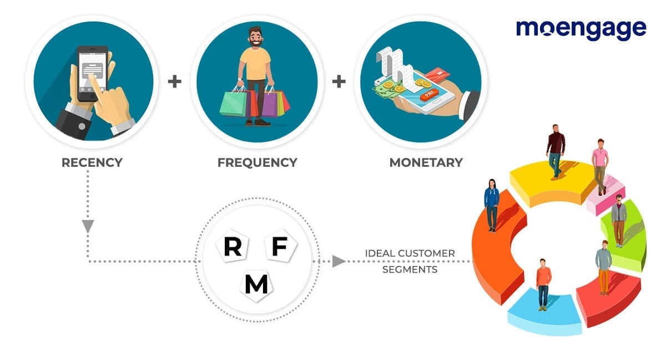
What is RFM?
Objective 2: Brief details based on monetary value, frequency of buy and recency of transaction.
Assign Recency, Frequency, Monetary Value to customers
Divide customers into tiered groups for R, F, M values
Select customized treatment for the groups
RFM Value – Recency Frequency Monetary Value
RFM analysis is done to quantitatively rank and group customers based on the recency, frequency and monetary value of their recent transactions.
This helps to identify the best customers and perform targeted marketing campaigns.

Slide 16
RFM Scoring
RFM scoring is done based on the quantile division of R, F & M values
Score | Recency (R value) | Frequency (F value) | Monetary (M value)
1(Lowest) | <88 | <15 | <38,885
2 (Moderate) | 80-180 | 15-30 | 38,885-85,860
3 (Moderate) | 180-270 | 30-48 | 85,860-2,07,500
4 (Highest) | >277 | >48 | >2,07,500
After finding out the individual R,F & M scores, the scores are added to get the RFM Score. The RFM Scores are further divided into 4 groups
RFM Score | Group
>10 | Champions
>8 & <=10 | Loyal
>5 & <=8 | Potential
<=5 | Promising

Slide 17
RFM Calculation
Example to understand the RFM scoring:
Objective 2: Brief details based on monetary value, frequency of buy and recency of transaction.
Recency: R value
Recency = Maximum Purchase date – Last Purchase date of customer
Customer ID 2 made his last purchase on 16th December, 2017
Recency value = 19.12.2017 – 16.12.2017 = 3 days
Frequency: F value
Frequency value = No of unique invoices for customer
No of purchases done by Customer ID 2 = 7
Monetary: M value
Monetary value = Total amount spent by customer
Monetary value of Customer ID 2 = 5,53,704
R score | F score | M score | RFM Score
1 | 1 | 4 | 6
Therefore, Customer ID 2 is a part of the Potential Segment

Slide 18
CUSTOMER SEGMENTS
Objective 2: Brief details based on monetary value, frequency of buy and recency of transaction.
Observation:
Majority of company’s customers belong to the Potential category, followed by Loyal and Promising categories.
Heavy focus needs to be driven towards retention strategies to prevent the customer base from low order recency, order frequency and revenue.
Despite most of our customer’s belong to the Potential and Promising segments, the Loyal and Champions segments are biggest revenue generators.

Slide 19
RFM Inference
Champions
Lowest R, Highest F, Highest M
Potential
Average R,
Average F,
Fair M
Loyal
Moderate R,
Moderate F,
Moderate M
Promising
Highest R,
Lowest F,
Lowest M
Champions are most important customers. Should be given best offers and discounts. Prime customer discounts, fast delivery.
Second best customers. Loyal customers to be focused to convert them Champions by increasing the Frequency and Recency. Happy Hours.
Potential customer to be focused on with highest importance to avoid them getting converted to Promising. Birthday discounts, Retaining strategies.
First strategy to retain and then to convert them to Potential.

Slide 20
CUSTOMER SEGMENTS
Objective 2: Brief details based on monetary value, frequency of buy and recency of transaction.
Customers belonging to the Champions segment tend to shop within every 5 days on an average, placing an approximately more than 50 orders throughout the year which generates the company a revenue of nearly 4.5 Mn per customer
Customers belonging to the Loyal segment tend to shop within every 25 days, placing an average of 10 orders throughout the year which generates the company a revenue of 550k per customer
Customers belonging to the Potential segment tend to shop within every 60 days, placing an average of 3 orders throughout the year which generates the company a revenue of 100k per customer
Customers belonging to the Promising segment tend to shop within every 250 days, placing an average of 1 order throughout the year which generates the company a revenue of 35k per customer

Slide 21
K – Means Clustering
Objective 3: Build an unsupervised learning model to analyze the customers
K means is used for creating and analyzing clusters
In this algorithm, ‘n’ no of data points are divided into ‘k’ clusters based on similarity
Initial data set
Select cluster center
Assign each observation to closest cluster based on distance
Any change in the cluster
Clustering is complete
Yes
No

Slide 22

BUILDING THE MODEL
K means clustering models create clusters based on distance between the data points.
Our original data is in a format where distance calculations would not help the clustering process.
Hence, we use the calculated Recency, Frequency and Monetary values to help the model build customer segments.

Slide 23
BUILDING THE MODEL
STANDARDIZING THE DATA
Columns used for model building are measured in different units which would cause the numbers with a higher scale to increase the distance and affect the clustering process.
Hence, we use the min max scaler to standardize the values between 0 and 1.
Finding the optimum k value (k = number of clusters)
We prepare a function to create models and store their WCSS values.
These WCSS values are then plotted as a line graph to identify the best value of k using the elbow method.
We see an elbow like shape in the plot post which the WCSS values drop and are closer to each other.

Slide 24
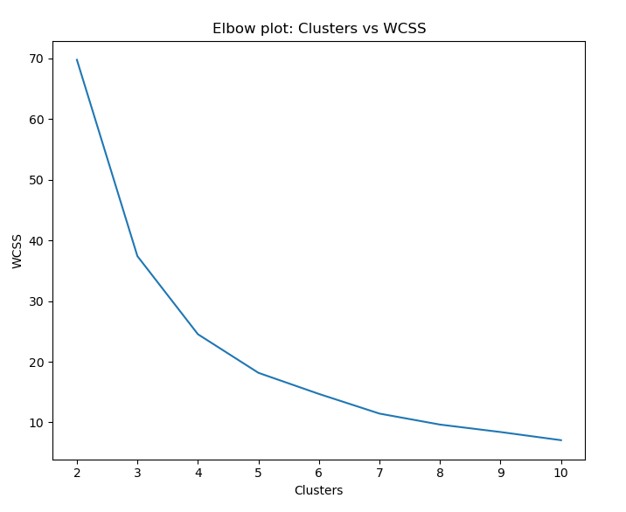
K Means – Elbow Method
The no of clusters
Based on the above plot we will segment the customers into 4 clusters, as the WCSS value do not decrease much after 4 clusters

Slide 25
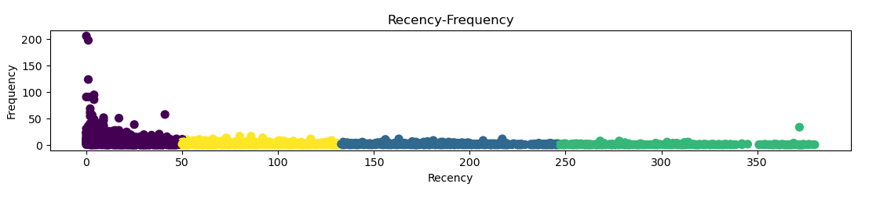
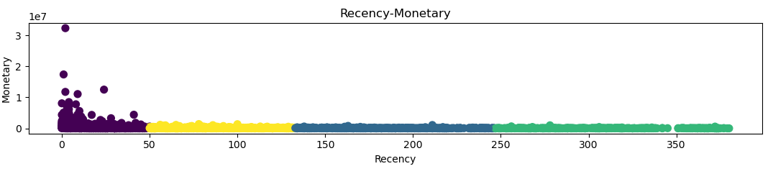
K Means Clusters

Slide 26
RFM VS K Means Inference
No. of clusters for RFM & K Means are 4.
No. of customers in each cluster are shown in the table
Segments | By RFM | By K-Means
Champions | 45 | 2108
Loyal | 938 | 1058
Potential | 2380 | 620
Promising | 947 | 524
Champions
1%
Loyal
22%
Promising
22%
Potential
55%
Champions
49%
Loyal
25%
Promising
12%
Potential
14%
RFM Segments
K Means Clusters

Slide 27
K Means VS RFM Inference
Mean Monetary value each cluster
Segments | By RFM | By K-Means
Champions | 4,66,601 | 3,58,129
Loyal | 5,43,683 | 88,180
Potential | 96,968 | 72,334
Promising | 35,000 | 48,135
Mean Recency value each cluster
Segments | By RFM | By K-Means
Champions | 5 | 19
Loyal | 23 | 186
Potential | 60 | 186
Promising | 248 | 306
Mean Frequency value each cluster
Segments | By RFM | By K-Means
Champions | 56 | 6
Loyal | 9 | 2
Potential | 2 | 2
Promising | 1 | 1

Slide 28
E- Commerce Conclusion
The customer segments predicted by the RFM and with K-Means clustering are different
According to K-Means clusters, the E-Commerce store is doing exceptionally well (70% customers are of same nature as Champions + Loyal)
According to RFM, the E-Commerce store is doing fairly good (40% customers are Champions + Loyal) & can improve by trying to convert Potential into Loyal

Slide 29
THANK YOU

